Slide 1
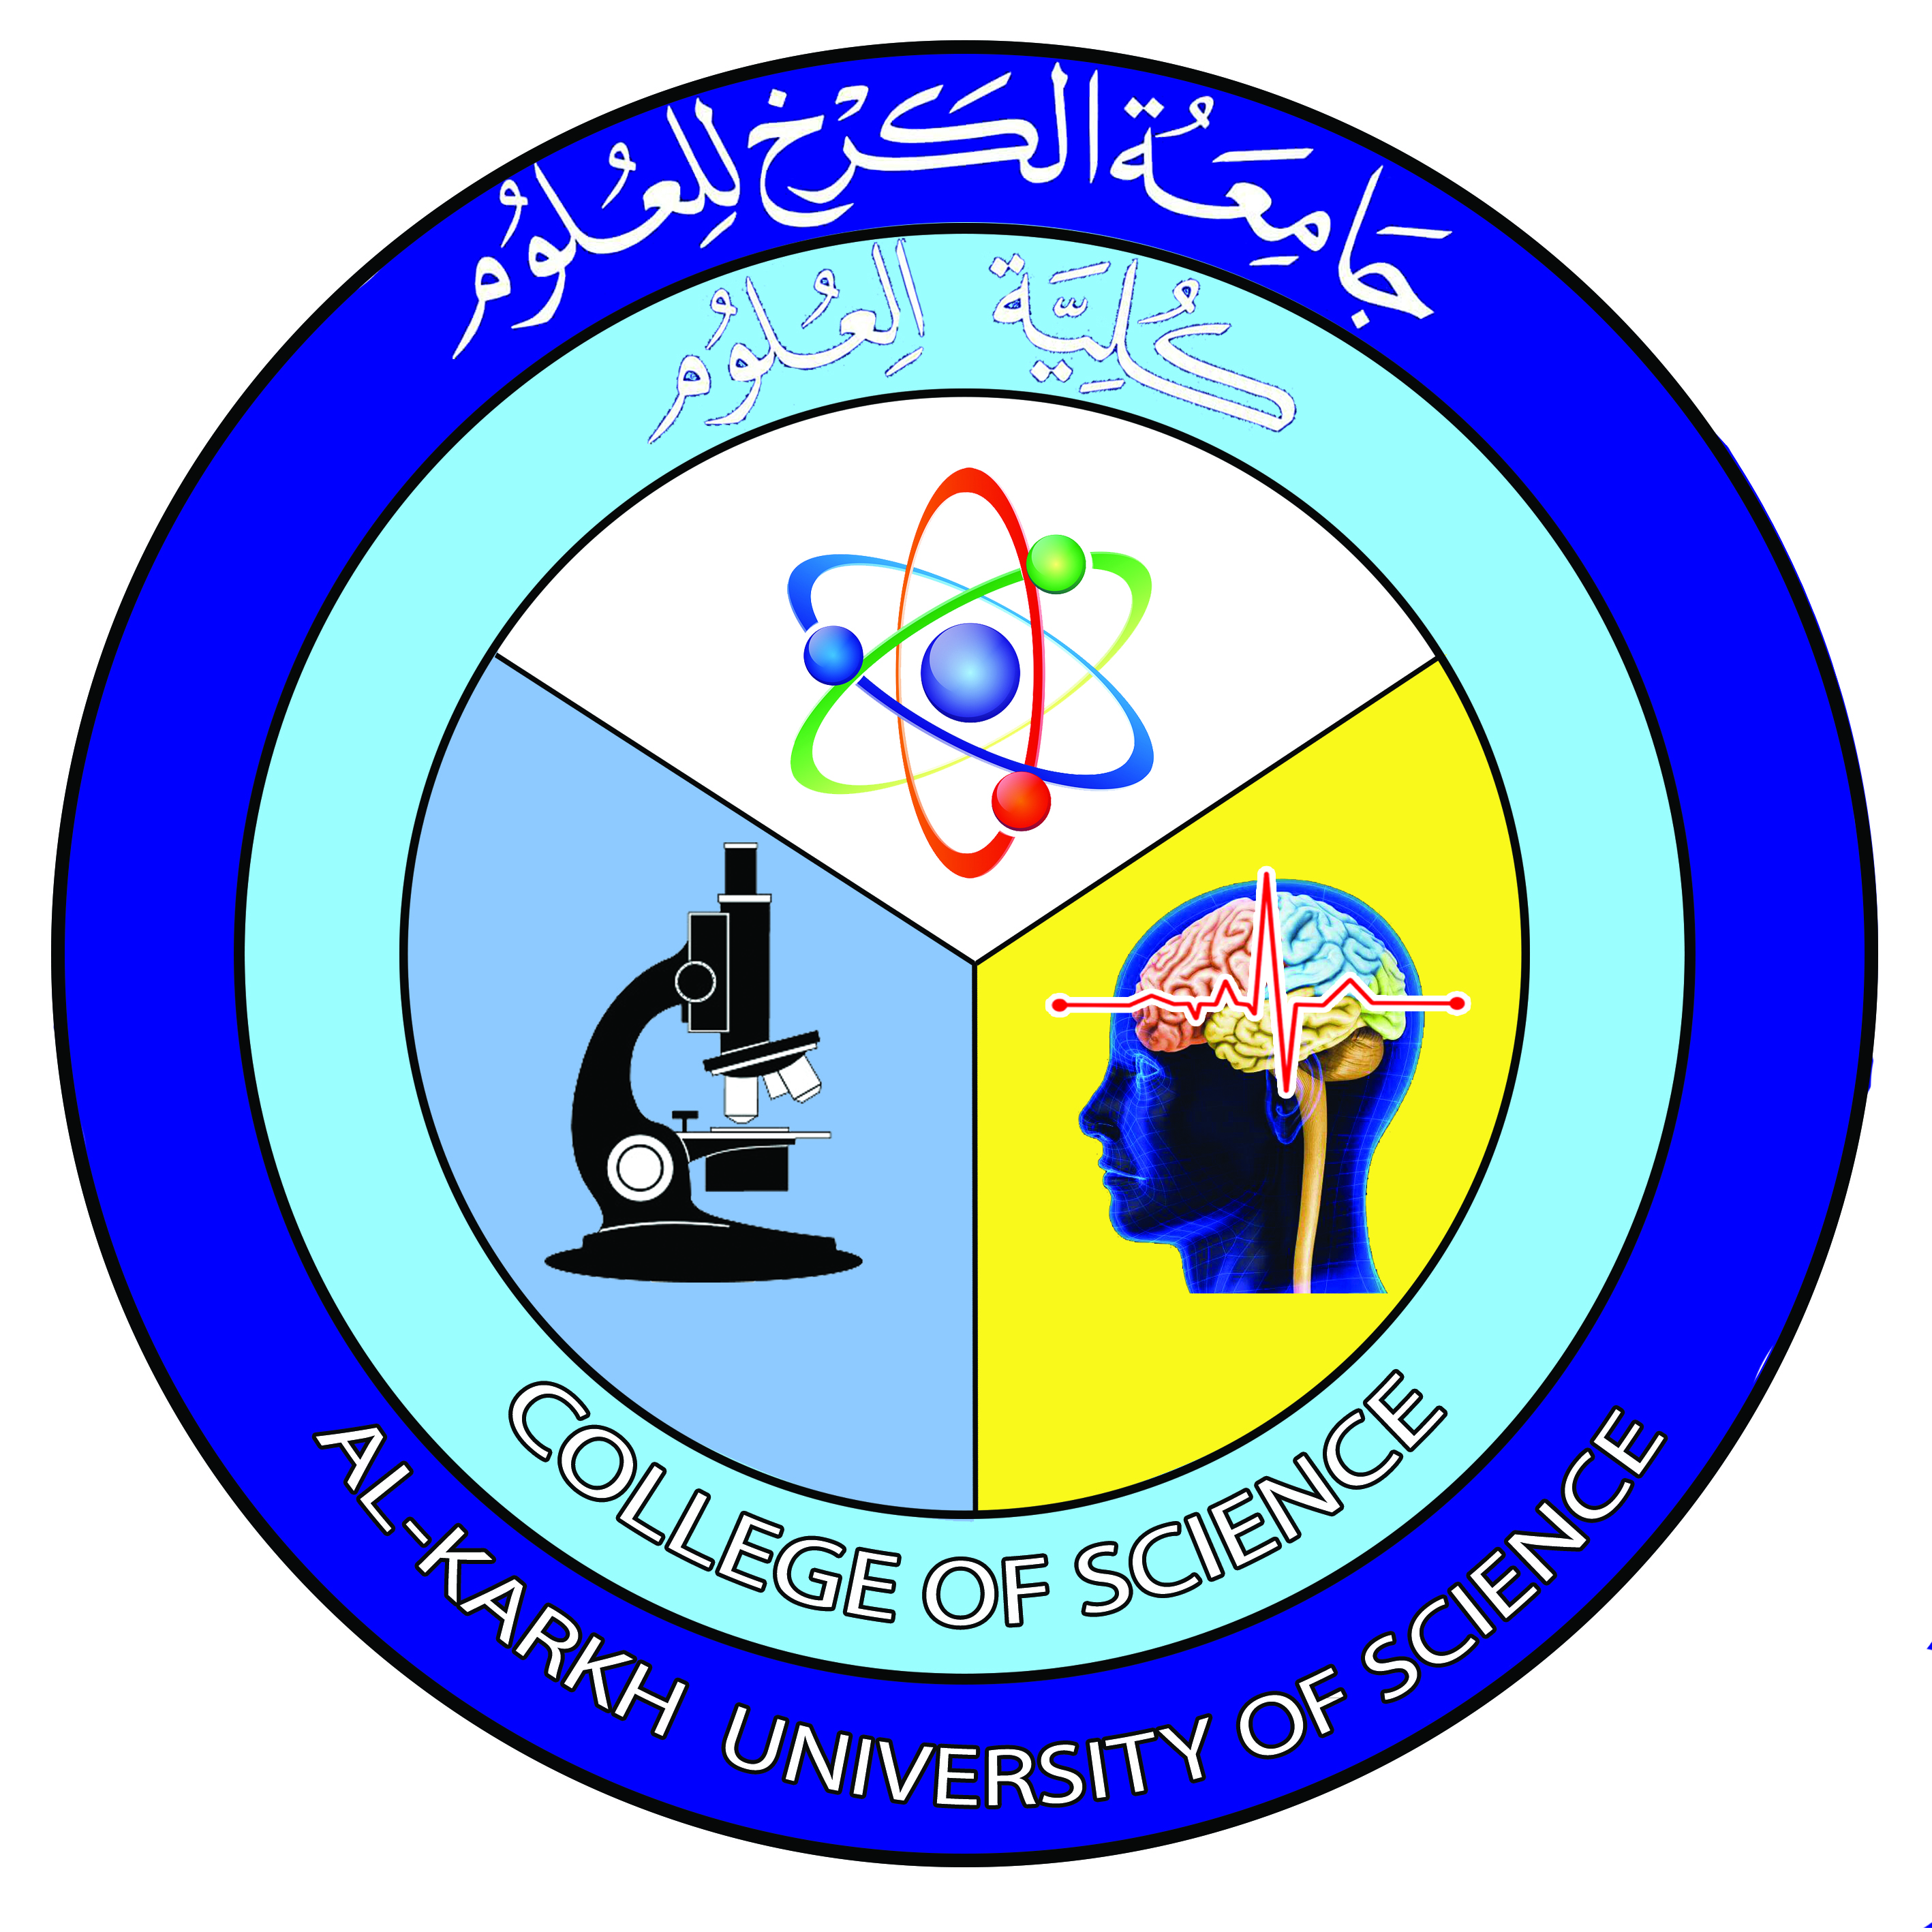

DNA Replication
Lecture 6 & 7
Dr. Rawa Abdul Redha Aziz
Ph.D Antibiotics/ Molecular biology

Slide 2
Introduction
DNA replication is the process of producing two identical copies from one original DNA molecule. This biological process occurs in all living organisms during the S-stage of interphase and it is the basis for biological inheritance. DNA is composed of two strands and each strand of the original DNA molecule serves as template for the production of the complementary strand, a process referred to as semiconservative replication and the process followed by proofreading or error-checking mechanisms to ensure correct reading to the genetic code

Slide 3
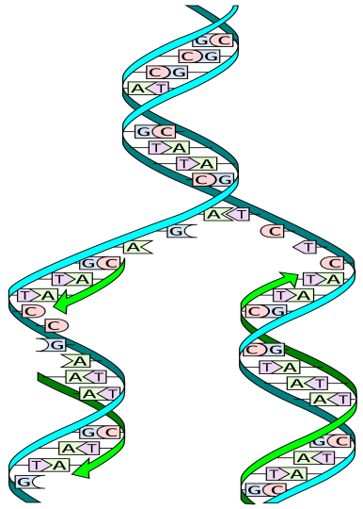

Slide 4
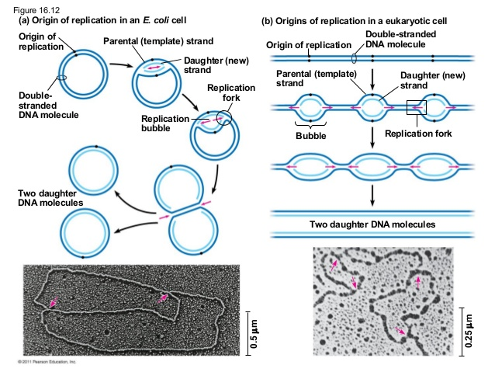
Prokaryotic and Eukaryotic DNA replication is bidirectional
Replication fork

Slide 5
DNA replication proteins
Enzyme
DNA Helicase
DNA Polymerase
DNA clamp
Single-Strand Binding Proteins (SSB)
Topoisomerase
DNA Gyrase
DNA Ligase
Primase
Telomerase

Slide 6
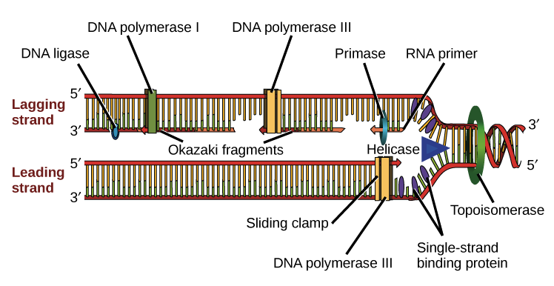
Replication process

Slide 7
Replication Stages
Initiation
Elongation
Termination

Slide 8
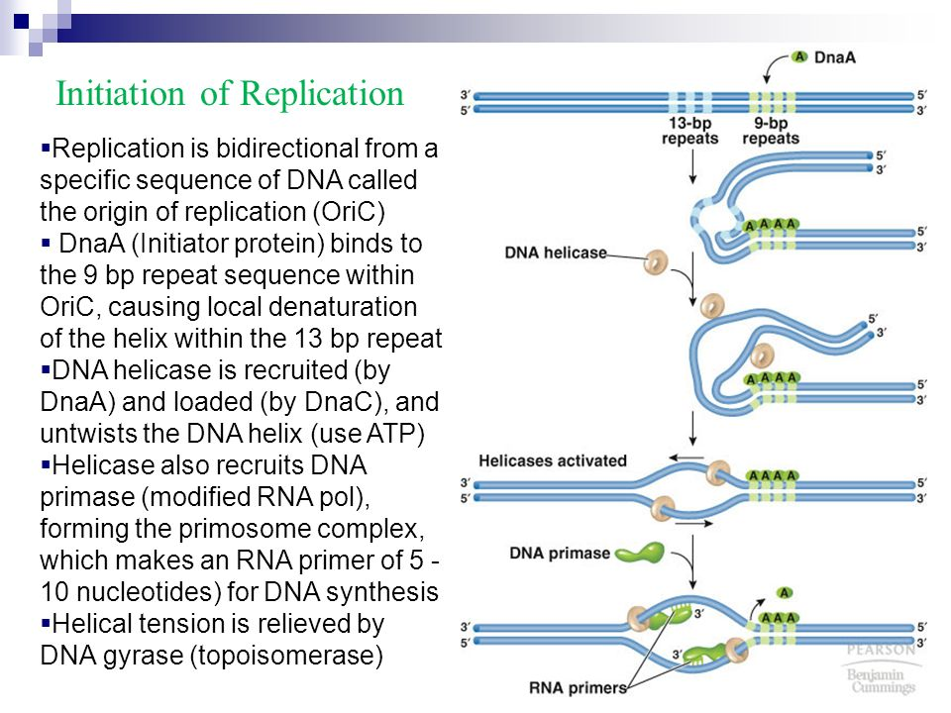
Initiation

Slide 9
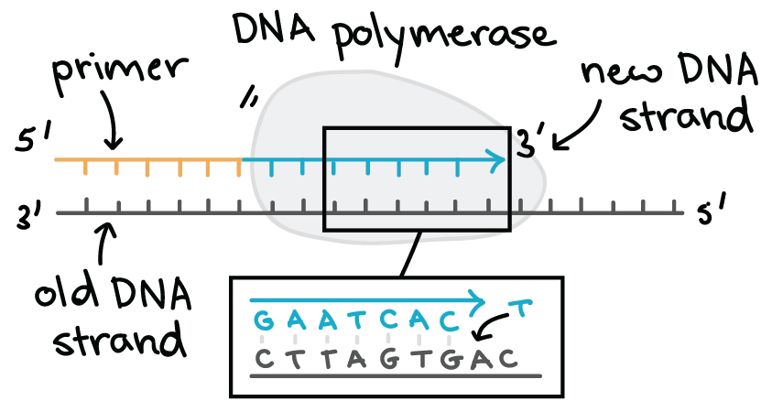
Elongation

Slide 10
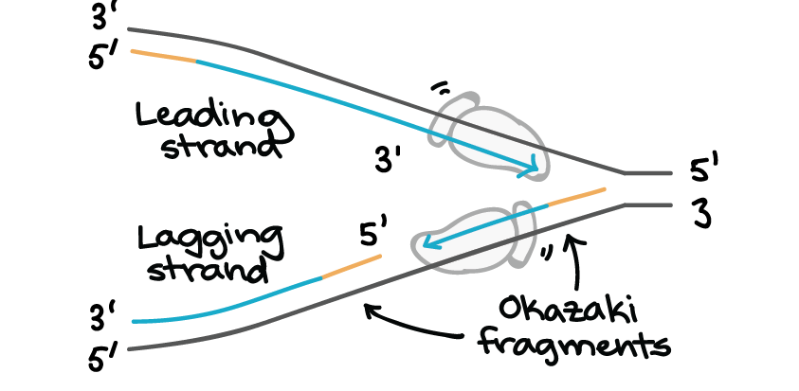

Slide 11
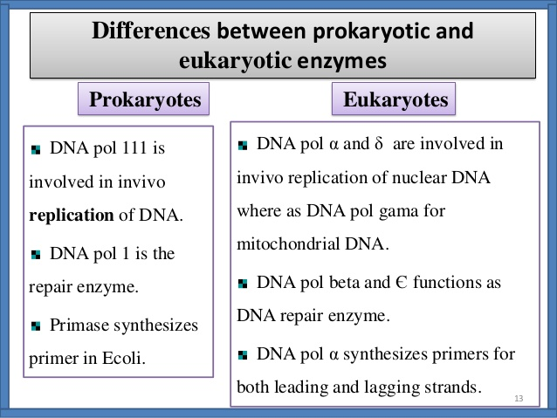

Slide 12
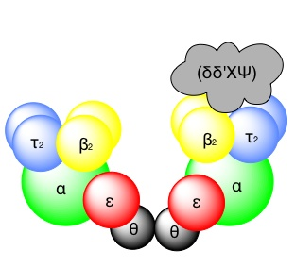
DNA polymerase equation

Slide 13
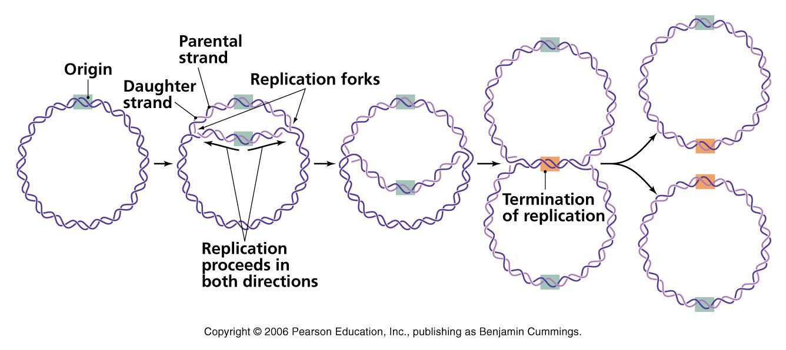
Termination

Slide 14
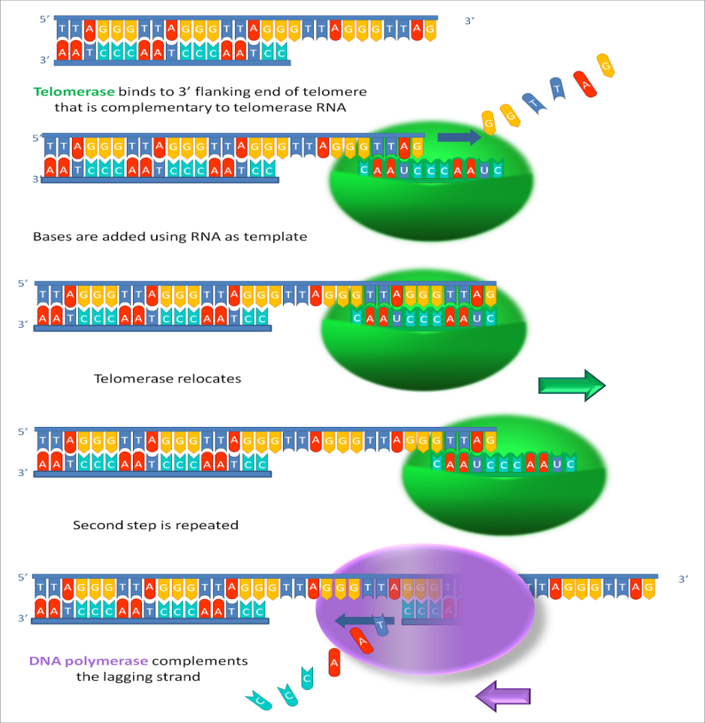
Hayflick limit

Slide 15
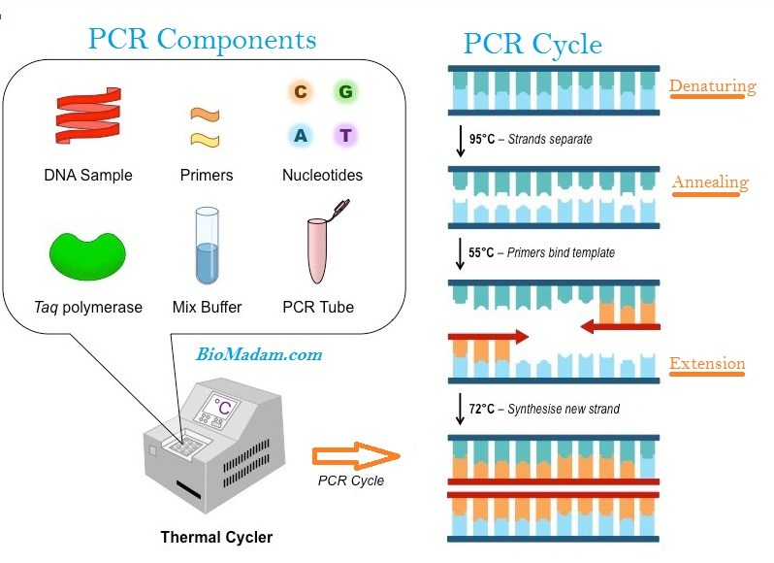
DNA could be synthesized in Lab

Slide 16


